Slide 1

ElderSensTM Innovative Elderly Care Solutions
March 2018
WWW.ELDERSENS.COM
ElderSens Confidential

Slide 2
The Problem and Our Solution
Existing Elderly Care Service:
Inaccurate
Labor-intensive
Expensive
ElderSensTM Enables:
Continuous monitoring, real-time alert
Multi-sensor integration
Cost effective
ElderSens Confidential

Slide 3
ElderSens Core Technologies
Advanced sensing technologies including Diaper Monitoring, Fall Detection, In-door Locationing…
Proprietary hybrid BLE/Wi-Fi mesh network providing enhanced coverage. Accurate in-door location supported with both iBeacon and Wi-Fi positioning technologies
ElderSens cloud is hosted on AWS with secure architecture and customizable configuration. The algorithms provide continues monitoring and real-time alert
ElderSens Platform is a vertically integrated ecosystem
ElderSens Confidential

Slide 4
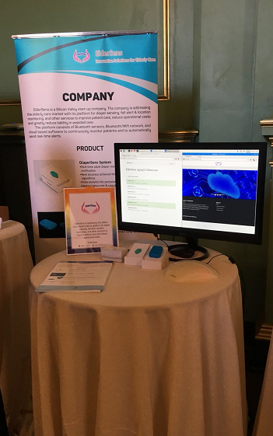
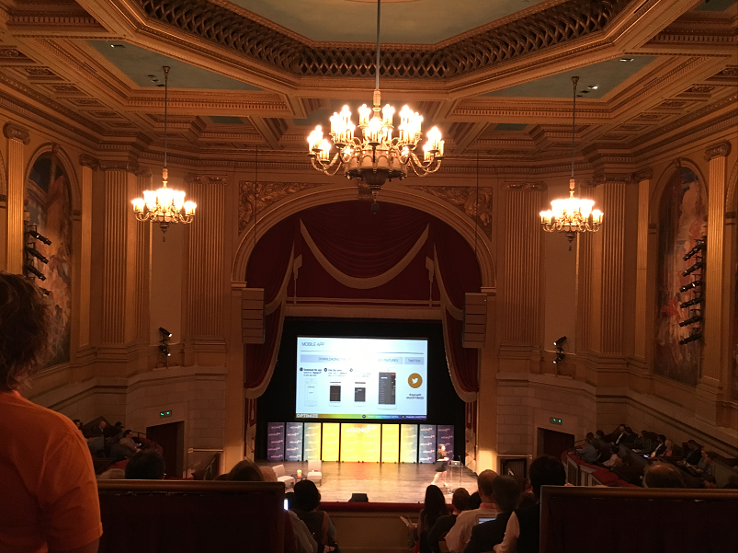
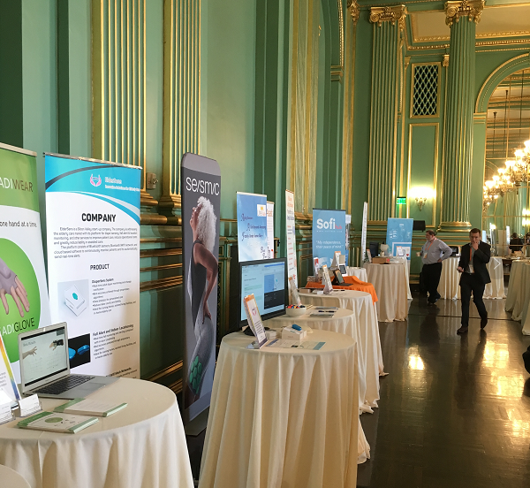

Exhibit ElderSens Ecosystem
ElderSens Confidential

Slide 5
DiaperSens System
Provide continuous adult diaper monitoring
Send real-time diaper change notification
Enable big data analytics
Reusable Sensor
Work with worldwide partners for clinical trials and system deployment to senior centers and hospitals
ElderSens Confidential

Slide 6

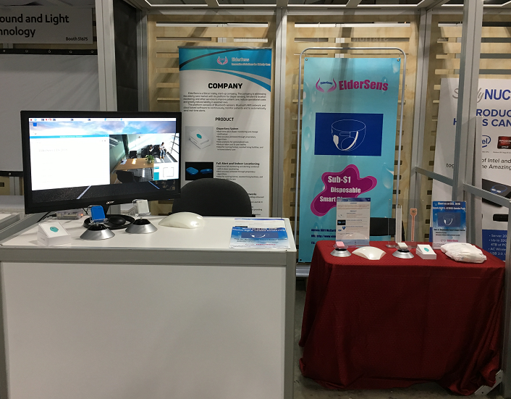
Unveil Disposable Smart Diaper
ElderSens Unveils Sub-$1 Disposable Smart Diaper Sensor at Las Vegas CES 2018
Work with diaper companies to integrate the sensor into adult and baby diapers
ElderSens Confidential

Slide 7
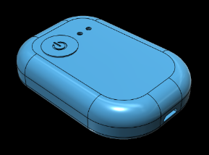
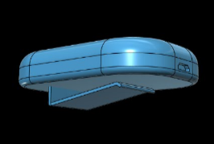
Fall Alert & Locationing
Variable Sensor
Provide continuous fall and location monitoring
Automatically send real-time fall alert with location notification
Geo-fencing service
Work on integrating the system into ElderSens Platform for clinical trial
ElderSens Confidential

Slide 8
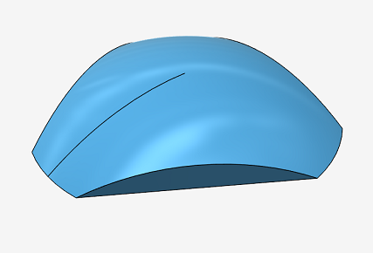
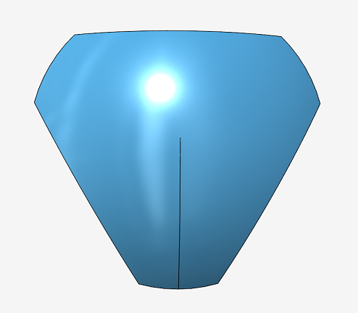
ElderSens Router and Network
BLE and Wifi Router
Proprietary in-door BLE/Wi-Fi network technology provides seamless coverage
Accurate location support with both iBeacon and Wi-Fi positioning technologies
Open SDK, API for integrating 3rd Party applications
ElderSens Confidential

Slide 9
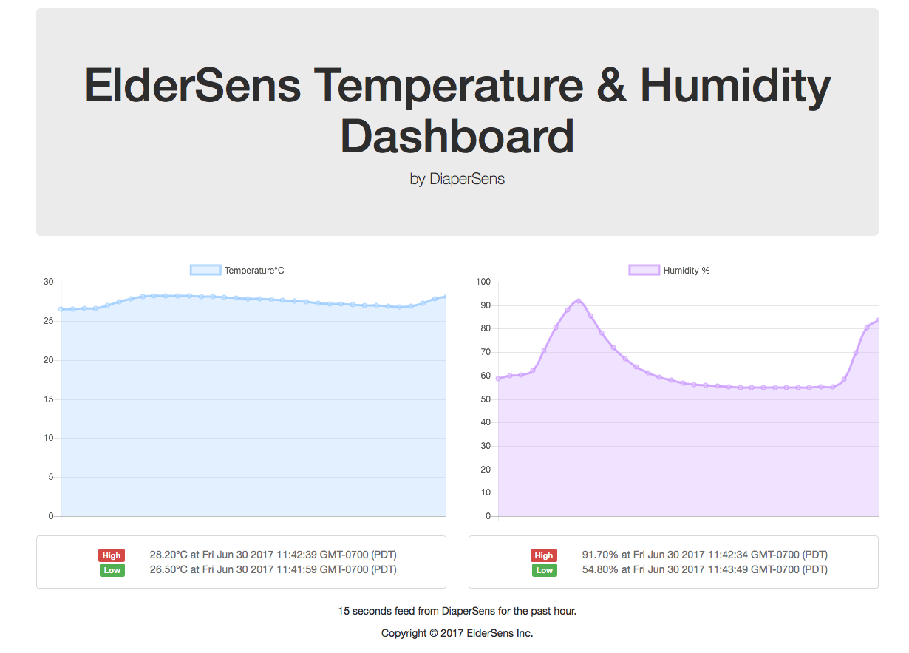
ElderSens Cloud
Secure architecture hosted on AWS
Intelligent learning algorithms for patient monitoring and sending alert notification to caregivers
Enable big data service
ElderSens cloud demo platform
ElderSens Confidential

